Slide 1
Amazon Customer Review Analysis
Team 5
Kapilan Ramasamy, Ming-Hua Tsai, Yash Mukesh Kothari, Hyun Sung Park
Big Data Analytics for Business

Slide 2
Project Goal
Price
Product Category
Reviews
How should seller price their products?
Does price influence customer ratings?
Are lower-rated listings priced appropriately?
Does richer product content (images, videos, longer descriptions) improve ratings?
Which product categories perform best when accounting for popularity and reliability?
Anything Amazon can do to improve it?
Address the business question of understanding what drives customer satisfaction and product performance on Amazon’s platform by linking customer reviews with product metadata

Slide 3


Data Source
1.
2.
(01)
(02)
(03)
(04)
(05)
(06)
(07)
(08)
(09)
(10)
User Reviews dataset
Item Metadata dataset
Cell_Phones_and_Accessories
Patio_Lawn_and_Garden
Contains customer reviews (rating, text, helpful votes, timestamps, verified purchase
Product-level data (title, description, price, category, average rating, images, features). Both datasets can be linked using the `parent_asin` field or the unique product identifier.
Arts_Crafts_and_Sewing
Office_Products
Grocery_and_Gourmet_Food
Automotive
Baby_Products
Musical_Instruments
All_Beauty
Health_and_Personal_Care

Slide 4
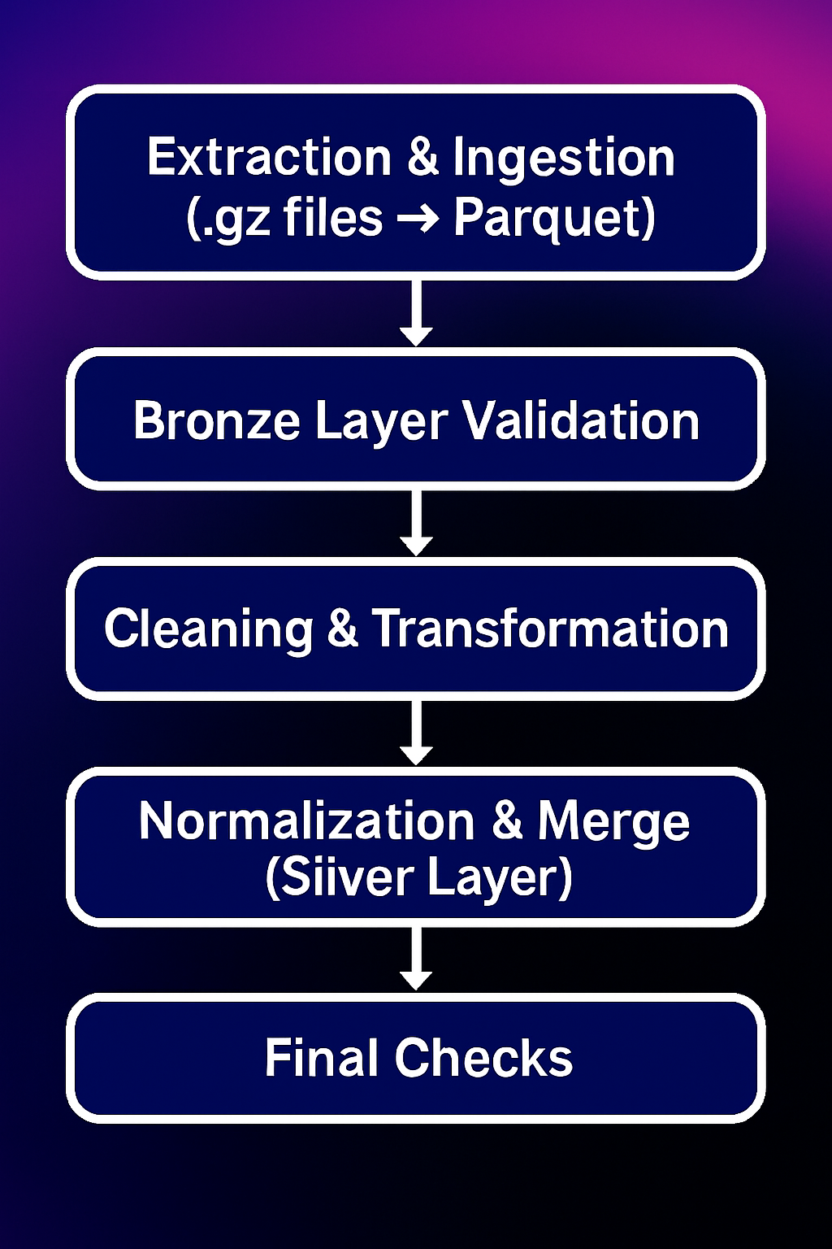
Data cleaning
Consolidated & validated raw .gz Amazon files into structured Bronze Parquet
Ensured schema consistency, verified record counts, and validated ingestion across all product categories.
Cleaned, standardized, and enriched metadata & reviews
Fixed missing values, normalized categories, mapped ASIN → parent ASIN, added brand/features flags, converted timestamps, and simplified nested image fields.
Built optimized Silver Layer tables ready for analysis
Merged categories, reduced noise, aligned metadata + reviews schemas, and performed final sanity checks (null ratios, percentiles, distribution checks).

Slide 5
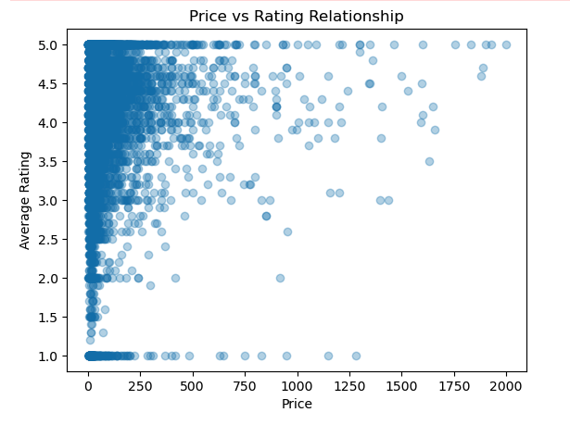
Let’s Dig into the Price first:
Does price influence customer ratings?
No clear linear relationship, pricing is not the direct driver of rating changes
Most products are under $250, but higher-priced and Items priced above $1250 rarely receive very low ratings (below 3)
Next Question:
Do I price my product correctly ?
Notes:
From the scatter plot, we can see that there isn’t a clear linear relationship between price and rating, meaning price itself isn’t a direct factor driving rating changes. What’s interesting, though, is that higher-priced products tend to show much more variability in how customers rate them, which suggests that expectations differ widely across users.
We can also notice that most Amazon products fall under the $250 price range, so the majority of data points are clustered on the left side of the chart.
As a next step, we could explore adjusting pricing strategies to identify potential “sweet spots” where customer satisfaction tends to be stronger. Doing so may help improve both conversion and overall sales efficiency.

Slide 6
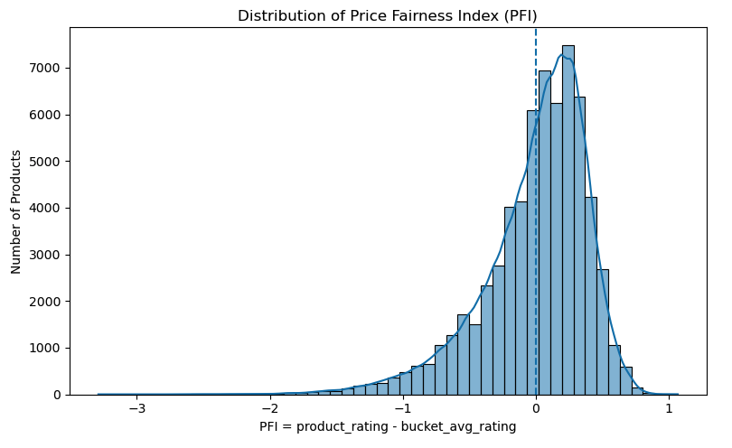
Is my pricing strategy fair?
Most products cluster near a PFI of 0, indicating pricing is generally aligned with category expectations,
A noticeable left tail (PFI < 0) reveals some overpriced products, which we can identify their category in the next step to help the sellers improve their pricing strategy.
Next step
Help sellers explore pricing “sweet spots” to strengthen satisfaction and boost conversion efficiency.
Notes:
When we look at the PFI distribution, most products cluster around zero, which tells us that sellers are generally pricing in line with category norms. Even so, small adjustments—up or down—can still influence how fair the price feels to customers.
What really stands out is the significant left tail, where PFI values fall below zero. These items are priced higher than similar products in the category. Overpriced items typically see weaker conversion, which means sellers have a quick opportunity to correct pricing and recover lost sales.
On the other hand, products with positive PFI scores are actually undervalued. These listings outperform their price level and could likely sustain a higher price without hurting customer ratings. For sellers, these represent high-potential opportunities to increase revenue while still remaining competitive in their category.

Slide 7
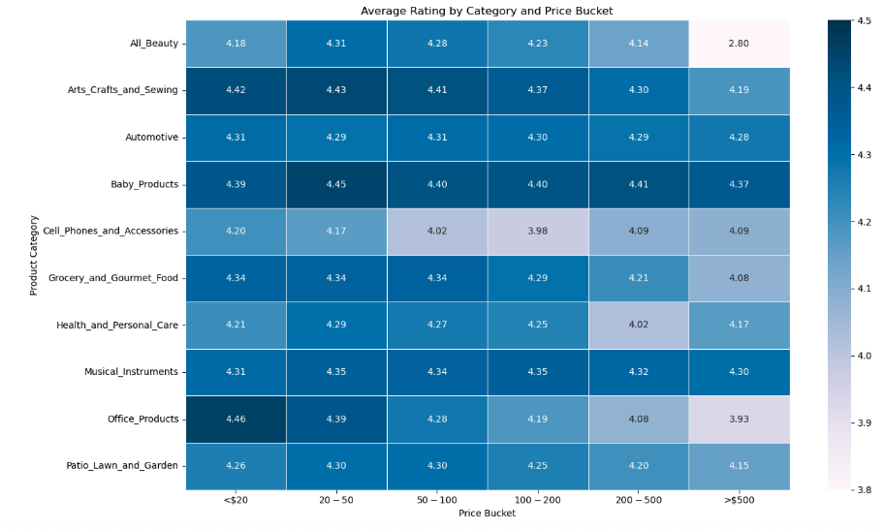
Is my product overpriced or underpriced compared to similar items in the same category?
I
Sellers can benchmark against category–price rating patterns to identify potential overpricing or underpricing.
High-price buckets(above $200) show clear rating declines across categories such as Cell Phones, Health & Personal Care, and All Beauty, indicating that premium pricing must be supported by strong product value to maintain customer satisfaction.
Notes:
From the analysis, we can see that some categories carry a disproportionately high share of underperforming products, which points to common pricing misalignment. Patio, Lawn & Garden and Health & Personal Care stand out the most—many products in these categories are priced higher than what customers believe they’re worth.
We also notice that in high-volume categories, even minor pricing mistakes become much more impactful. In categories like Cell Phones & Accessories or Grocery & Gourmet Food, just a small percentage of mispriced items can translate into thousands of listings that underperform, which signals a large opportunity for optimization.
For sellers, this creates a strategic advantage. By focusing on categories where underperformance is widespread, they can differentiate much more quickly. When competitors tend to overprice, applying thoughtful pricing strategies becomes an effective lever to improve ranking, attract more clicks, and ultimately increase conversion rates.

Slide 8
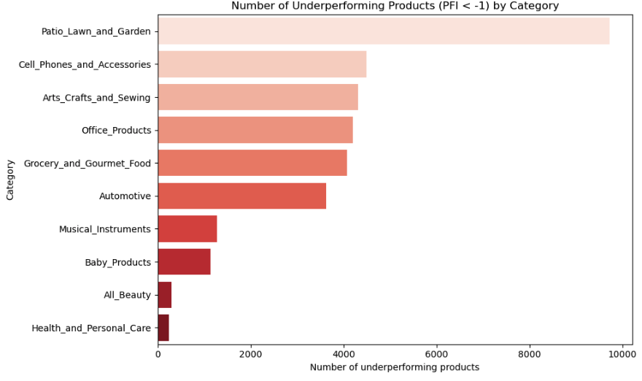
Which category is most underperformance?
Focusing on high-underperformance categories accelerates differentiation
- High-volume categories amplify pricing errors.even small mispricing leads to weak listings and large optimization opportunities.
- High underperformance,: Patio, Lawn & Garden

Slide 9
Do the most expensive items justify their price when compared to their ratings?
Need more visualization
The chart reveals that several listings cluster around the lower end of the rating spectrum, indicating that multiple products or services are underperforming in terms of customer satisfaction. Ideally, a healthy marketplace or product portfolio would display a scatterplot concentrated toward the upper-right quadrant—signifying higher ratings and potentially stronger value propositions relative to their price points. #However, in this case, the dense concentration of data points in the bottom-left area suggests a mismatch between price and perceived quality. This could mean that customers feel the offerings are overpriced for the value delivered, or that there are fundamental issues with quality, service experience, or product relevance.

Slide 10
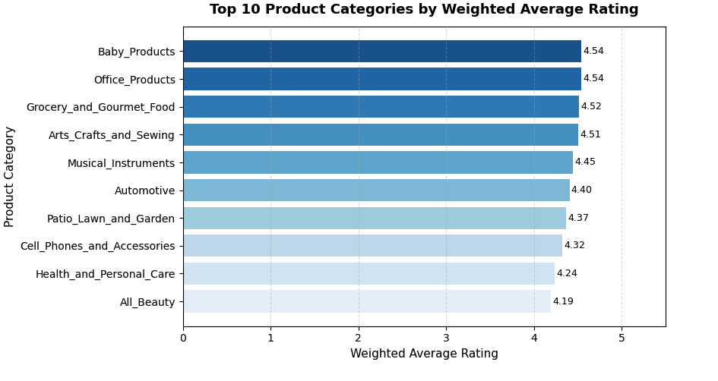
Let’s dig into product categories: Which product categories perform best when accounting for popularity and reliability?
• High Avg. Ratings
: Baby Products, Office Products, and Grocery & Gourmet Food
• Low Avg. Ratings : Beauty, Health & Personal Care, and Cell Phones
• Ratings tend to be higher on simple, functional product categories where items don’t need much differentiation
• Ratings tend to be lower on products where customers expect more personalized products and have diverse preferences

Slide 11
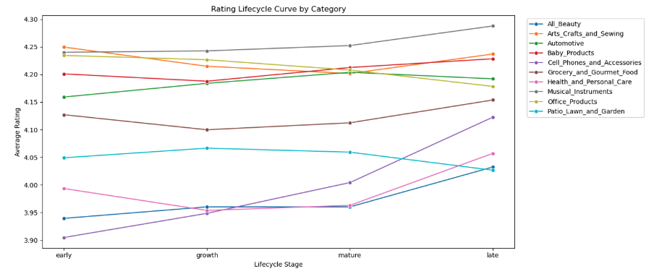
How long should a product post stay up to maximize rating?
• Ratings often dip slightly during the growth stage before stabilizing or rising in maturity. : Increased competition / More critical early reviews in early stage
• Mature and late-stage products consistently score higher in certain categories.
: Long-term trust / Refined product lines / Stability
• Underperforming categories in early stages often catch up later, suggesting room for optimization.
: Improve early-stage performance (better descriptions, pricing, and review strategy)

Slide 12
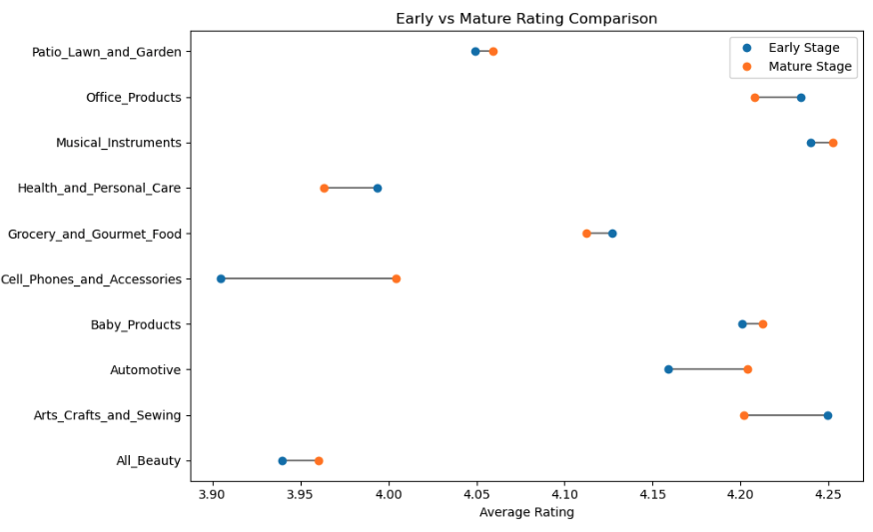
Product life cycle: Is my product overpriced or underpriced compared to similar items in the same category?
• Most categories see rating improvement as products mature
: customer trust builds over time, highlighting the value of sustained quality and optimized listings.
• Early-stage products with lower ratings may be suffering from unclear descriptions, insufficient reviews, or unmet expectations
: Improving these signals early can accelerate sales growth and competitive positioning.
• Mature-stage leaders show stable high ratings thus indicating strong long-term product–market fit
: A benchmark for what “healthy lifecycle performance” looks like.

Slide 13
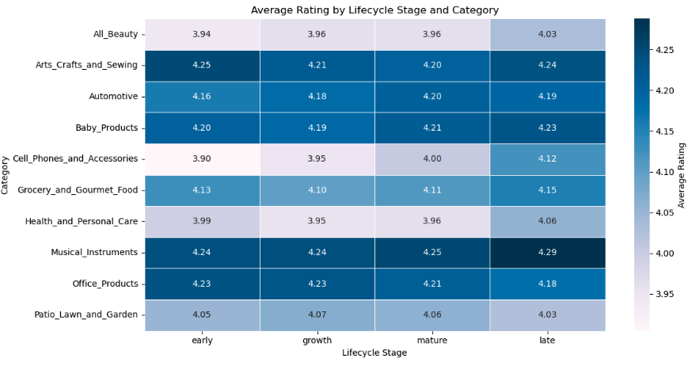
Product life cycle
• Ratings generally improve as products move from early → mature stages, suggesting that customer trust and product-market fit strengthen over time.
• Some categories start weaker in early stages, indicating higher sensitivity to product quality, listing clarity, and early reviews key areas sellers can improve to accelerate growth.
• Mature-stage consistency across most categories shows that sustained quality and optimized pricing lead to stable, strong product performance, giving sellers a blueprint for long-term success.

Slide 14
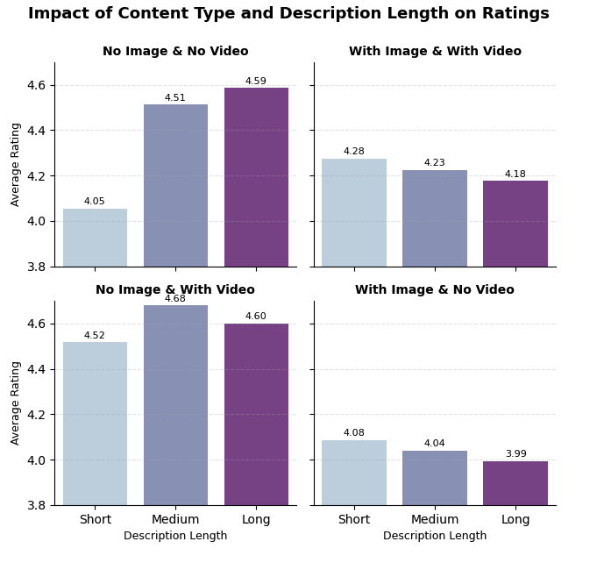
Let’s Dig into the product content and reviews!
Richer content alone doesn’t consistently increase ratings long descriptions and long reviews appear across both high and low star ratings.
Quality and clarity of content matter more than length: setting accurate expectations reduces early negative reviews and returns.
Visual assets and videos are more impactful in certain categories (e.g., tech and complex products) where customers rely on demos to judge value.
Additional analysis - Trust signals like verified purchases and highly upvoted critical reviews are strong indicators of underlying product issues that sellers should monitor.

Slide 15
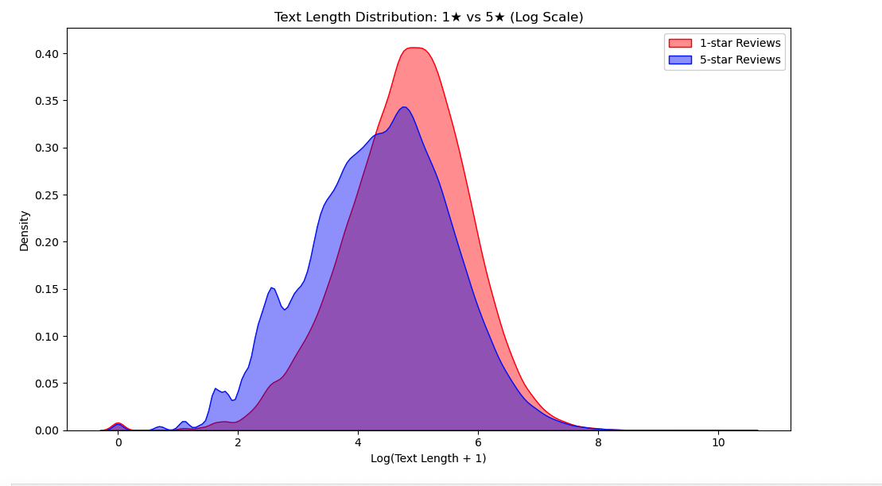
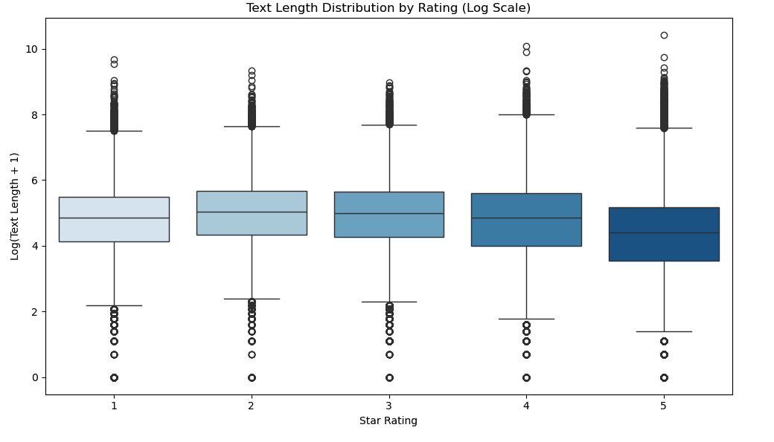
Text length
• Review length shows no meaningful relationship with rating levels of short and long reviews appear across all star ratings.
• 1-star and 5-star reviews have overlapping text-length distributions, meaning customers express strong opinions concisely or verbosely regardless of sentiment.
• Text length does not predict review quality or customer satisfaction, so sellers should focus more on verified purchases and product performance, not wording length.

Slide 16
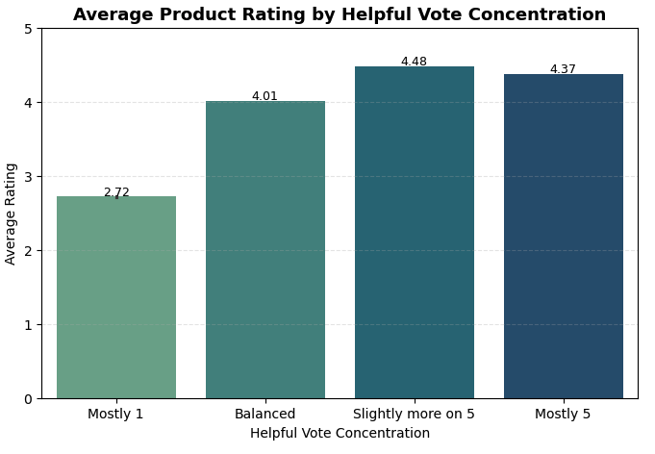
Helpful Votes and Ratings:
Does helpful votes on negative reviews indicate low ratings?
A relation between Helpful votes & Avg. customer ratings
The data shows that average ratings decline as helpful votes on critical reviews increase.
This trend on ‘Helpful votes’ signals potential product or service issues that could harm seller reputation.
Sellers should monitor highly upvoted critical reviews and address underlying problems promptly.
Notes:
Amazon customers can evaluate not only the products but also customer reviews, and it is called helpful votes.
It is used for customers as a reliable evaluation to quickly review the product.
Then, can seller also use helpful vote as one of their indicators?
In charts Mostly 1 means that helpful votes mostly concentrated on 1 star reviews, and it clearly shows relatively lower average rating.
In contrast, when helpful votes mostly focused on 5 star ratings review, it showed higher average ratings.
So helpful votes does reflects the general ratings on products, and sellers can see helpful votes as a key indicator.
To control average ratings on their products sellers should monitor highly upvoted negative reviews and figure out the issue promptly.
Helpful votes have been used mostly for buyers, but it can also be a valuable indicator for sellers as well.

Slide 17

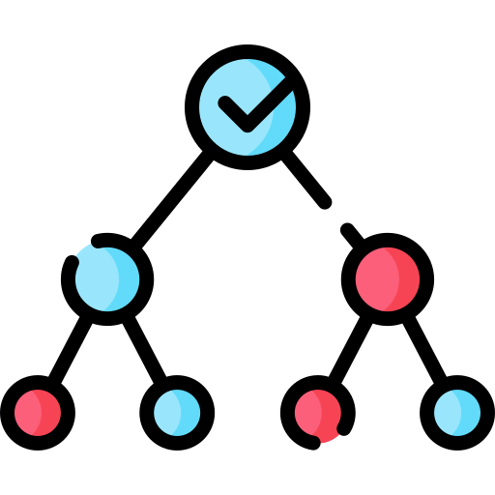


Machine Learning Analysis
Model 1 - Average rating prediction (Random Forest)
Input: Product category, # of words in description, Price, Product image, Product video
Output: Predicted avg. rating for the product
Result: Failed….(Model failed to reach reasonable model accuracy)
However…we learned feature importance from training the model!
Model 2 - Negative Review NLP Analysis (LDA)
Input: Review text, Review rating
Output: Words categorized in groups in negative reviews
Result: Insights for understanding reasons of negative reviews
Notes:
After our EDA phase, we went further deep down to analyze the data with ML.
We had two models in plan. First, average rating prediction model with seller’s actionable variables such as price or description details. Second is negative review NLP analysis that categorizes words from negative reviews.
NLP model worked properly, but we failed to construct reliable model on prediction model. We had limitations on features we could use, and we could only use “actionable” features that sellers can tune to optimize the ratings.
However, Random forest has built-in feature importance to see the importance of each features.
We could learn some lesson from this stage.
Random Forest is a machine learning algorithm that uses multiple decision trees working together to make more stable and accurate predictions.
Used Random Forest’s built-in impurity-based feature importance to see feature importance

Slide 18
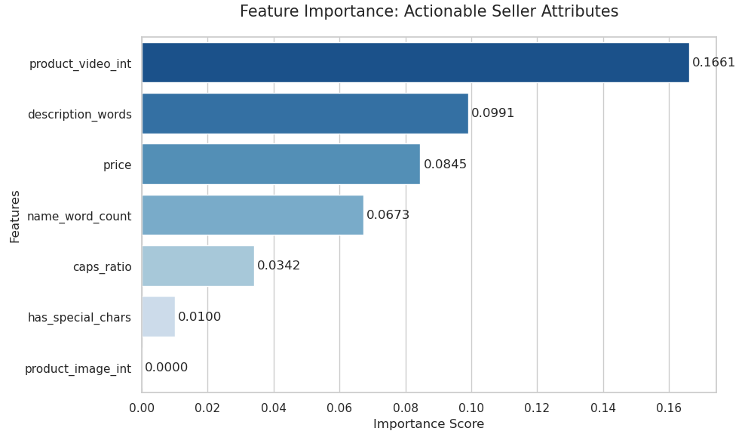

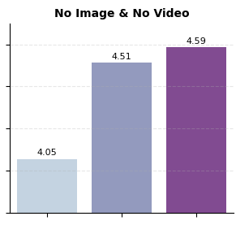
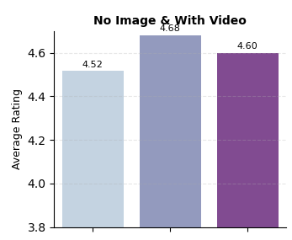
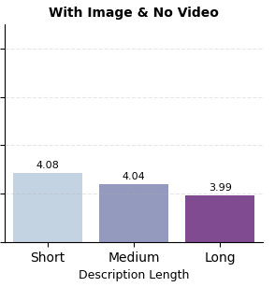
Feature Importance Analysis:
Which features does the model rely on the most when making predictions?
Most powerful feature for prediction model: Product video
Less Important feature for prediction model: Product image
We observed this in the previous EDA!
Notes:
As you can see existence of product video and number of description were heavily used in the model, and product image was nearly not used in training the model.
And we could see the similar insight from previous EDAs. So it emphasizes the importance of the video and degree of details in description
Even with a low R², model-based feature importance can still provide insights because it reflects how the model actually uses each feature during prediction.
Unlike EDA, which only captures simple statistical correlations, the model considers nonlinear relationships and feature interactions that EDA cannot detect.
Therefore, even a weak model may still highlight meaningful feature usage patterns that are not visible from basic EDA analysis.

Slide 19
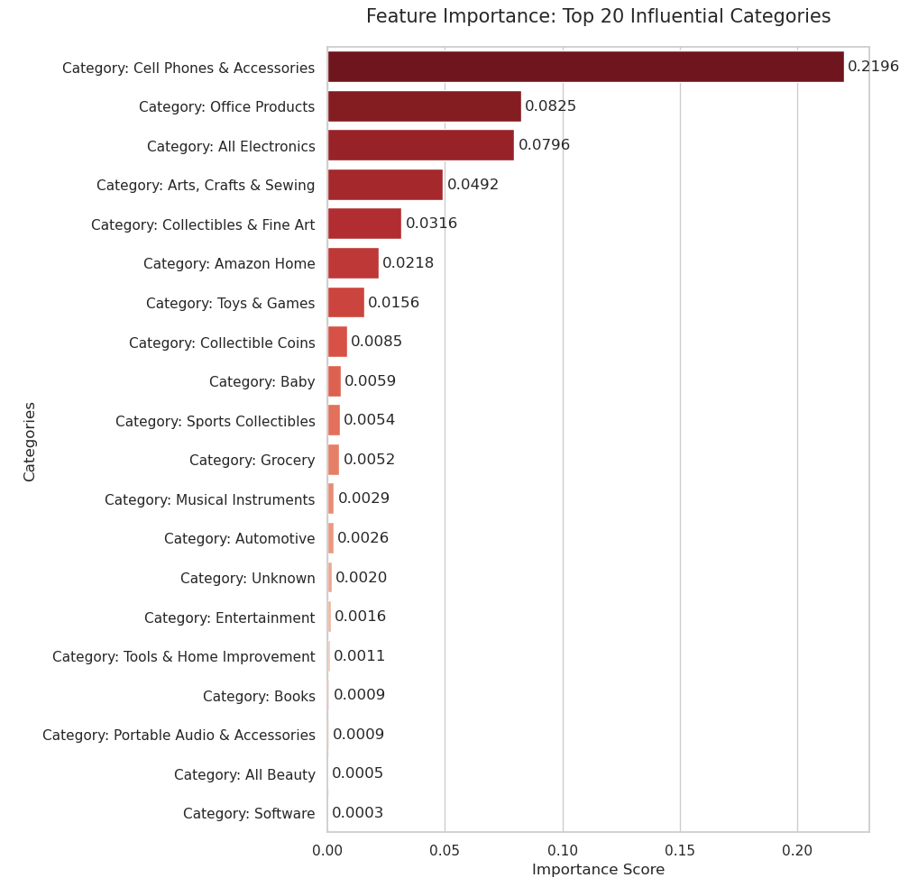





Feature Importance Analysis
Highest importance:
Cell phones & Accessories / Office Products /
All Electronics / Arts, Crafts & Sewing
Lowest importance:
Books / Portable Audio & Accessories /
All Beauty Items / Software
What it means in Product Categories?
: the category provides a strong, self-contained signal and is relatively less influenced by other features compared to lower-importance categories.
Notes:
In category perspective, cellphons and accessories was heavily used in training the model, and it indicates that this category has unique pattern affecting avg. rating, besides from other features like price. So in those categories, sellers should focus more on their unique features for example, malfunctions or package.
The “Cell Phones & Accessories” category provides a strong and independent signal for predicting product ratings, more influential than other inputs such as price, product image, or product video.
Its rating patterns differ clearly from those of other categories, allowing the model to separate high- and low-rated products more effectively when this category is known.
In other words, simply belonging to this category carries meaningful information about expected rating outcomes, beyond what other features can explain.

Slide 20
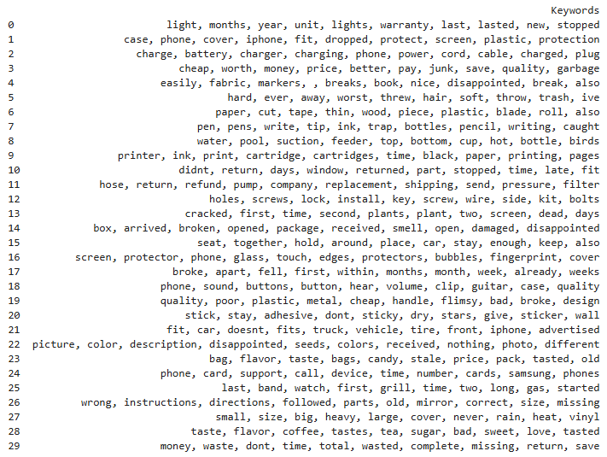
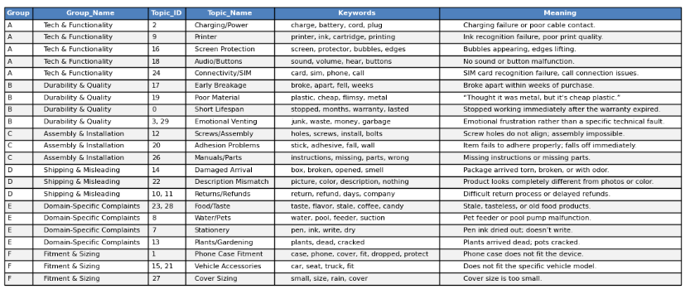
Machine Learning Analysis
Identified key complaint themes from 1–2 star reviews using NLP
Grouped recurring issues into major categories (e.g., tech failures, durability, shipping, sizing).
Sellers can apply the same method to their own product groups to uncover product-specific complaint patterns.
Used LDA topic modeling pipeline
What is LDA?
LDA (Latent Dirichlet Allocation) is a topic modeling algorithm that automatically discovers hidden themes in large collections of text. It groups together words that frequently appear together and identifies the main topics within the documents.
Notes:
Lastly, we used LDA modeling pipeline for NLP.
We collected 1 to 2 rating reviews, grouping words from those reviews.
We then used chatGPT to categorize those words to see the actual reasons why they complains about products.
In this analysis we operated the model on the whole dataset, but sellers can focus on their products so that they can uncover product-specific complaint patterns.
I used a cleaned set of negative reviews and applied an LDA topic modeling pipeline.
After preprocessing the text, I extracted keywords from each topic generated by the LDA model to identify the main themes in negative customer feedback.
LDA (Latent Dirichlet Allocation) is a topic modeling algorithm that automatically discovers hidden themes in large collections of text. It groups together words that frequently appear together and identifies the main topics within the documents.

Slide 21
Conclusion
Key Insights
ML Analysis
Content Quality Matters: Strong videos and product descriptions help raise ratings.
Helpful Votes Matter: Track helpful votes! they significantly influence overall ratings.
Early Reviews Matter: Encourage early customer reviews to boost long-term rating performance.
Feature Importance Sellers should focus on video contents and degree of details in description. The Cell Phones & Accessories category requires careful attention to its unique factors, including product quality, defects, and delivery-related issues.
LDA Topic Modeling Quickly surfaces key reasons behind negative reviews to help sellers address major customer concerns.
Notes:
In conclusion we remind which valuable insight we can give to Amazon sellers to earn better customer reviews?
From EDA, we could learn that contents quality matters especially in video contents and depth of description details.
Also, Helpful votes does matter, so sellers may want to monitor carefully on highly upvoted reviews to detect whether their product have significant issues.
Early stage reviews are also important. Sellers should encourage early stage customers to see long-term advantages for their products.
In ML phase, we have done feature importance analysis.
As we have seen in EDA phase, video contents and degree of details in description matters. And some categories such as cell phone requires special care since they have unique factors other than price and descriptions.
With NLP model, sellers can quickly surfaces key reasons from massive amount of negative reviews to address major customer concerns

Slide 22
THANK YOU!
Questions?
Notes:
Key Learnings
High-Quality Content Drives Higher Ratings Video content and clear, compelling product descriptions are essential for improving customer ratings. Strong product media significantly enhances buyer confidence and perceived value.
Monitor Helpful Votes to Understand Rating Impact Helpful votes strongly influence overall ratings. Sellers should regularly track this metric to understand which reviews shape customer perception the most.
Early Review Accumulation Boosts Long-Term Rating The number of reviews accumulated throughout a product’s lifecycle positively impacts its rating. Encouraging customers to leave reviews—especially in the early stages—can help elevate the product’s long-term rating trajectory.
LDA Topic Modeling for Review Insights
Helps sellers quickly analyze large volumes of critical reviews by identifying and categorizing the key drivers of negative customer feedback.
Price Prediction Model for Optimal Pricing
Uses historical and competitive data to recommend the most effective pricing strategy, helping sellers maximize revenue while staying competitive.
wo Models to Support Amazon Sellers

